Slide 1
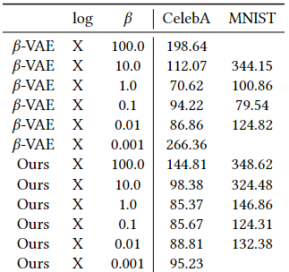
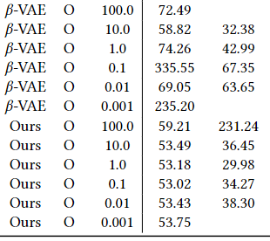
CelebA Result
The result is very good! (as expected)
‘log O’ means optimal decoder variance implemented by logMSE
Namely, ‘log O’s are decoupled ones and ‘log X’s are coupled one

Slide 2
CelebA Result
Coupled VAE (i.e. without considering the variance) is worse
Note the red ones; optimal likelihood model (optimal variance & maintaining likelihood context via beta=1) still has room for improvement to have good sampling quality

Slide 3
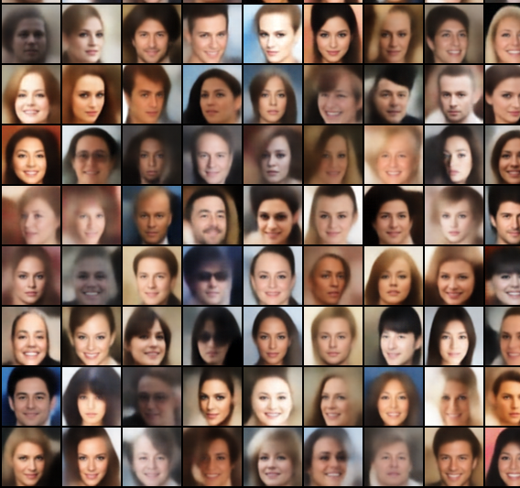
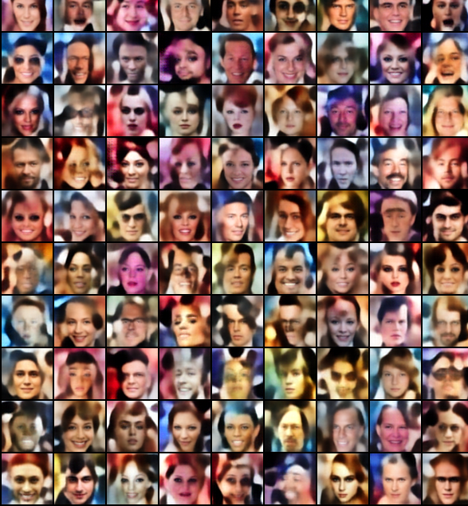
Samples
Reconstructions are always good enough because they have optimal decoder variance
But the sampling quality is much better with high beta value!
Optimal Variance
Beta=1
Optimal Variance
Beta=10

Slide 4
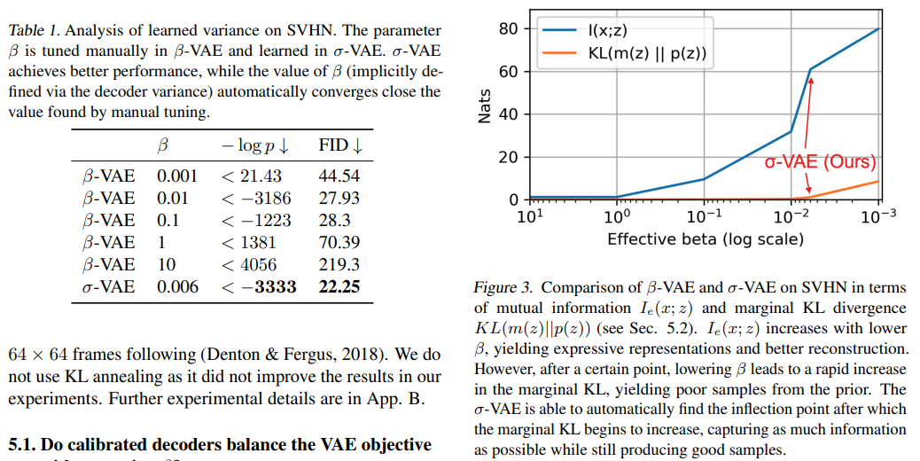
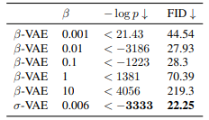
Current Situation
To strengthen my argument, I have been looking at the previous claims
e.g. in ‘…Calibrated Decoder…’, the authors search for optimal beta
But why does optimal likelihood implies optimal beta?
Beta is not designed to find optimal likelihood
Extreamly, the near-zero beta-VAE (similar to autoencoder)
Will have best likelihood

Slide 5
Current Situation
I thought my ideas were a bit lacking in novelty
(beta-input VAE & decoupling beta from variance)
I tried to put this together, but this seems to have a negative effect on each novelty
It would be better to research seperately

Slide 6
Current Situation
First, I want to focus on the decoupling topic
However I believe that the correction of the incorrectly mixed context (beta & var) of previous works and/or simple performance results are insufficient
I will try to think of some unique experiment,
Or mathematically formalize the unregulated situation created by mixed context
If there are one or two, I think the paper will be meaningful!

Slide 7
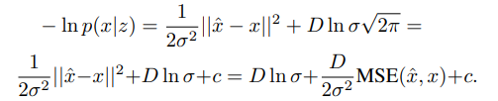

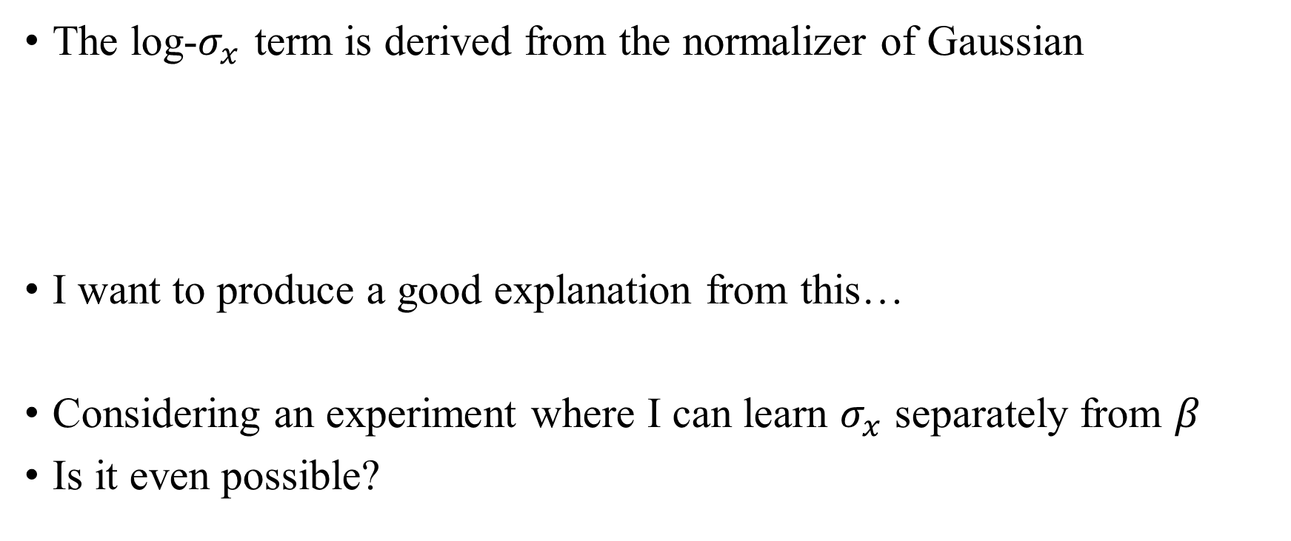
This Week’s Progress
The log-$σ_{x}$ term is derived from the normalizer of Gaussian
I want to produce a good explanation from this…
Considering an experiment where I can learn $σ_{x}$ separately from $β$
Is it even possible?

